Slide 1




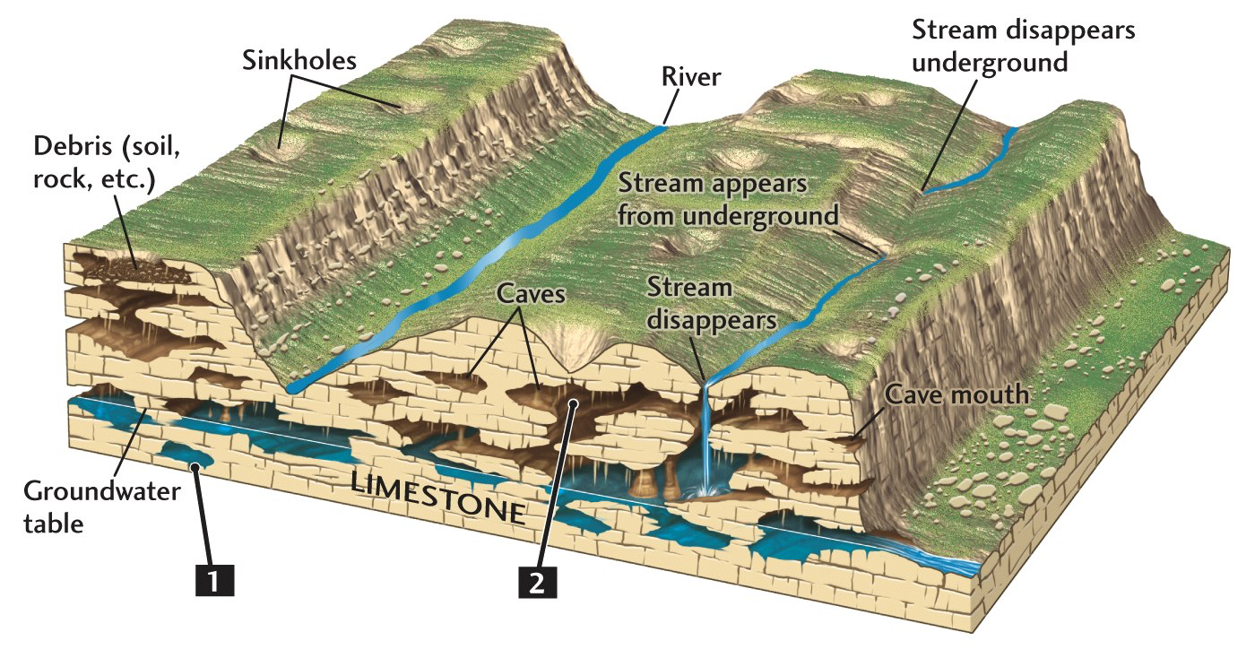
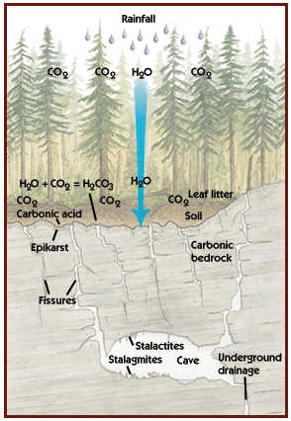
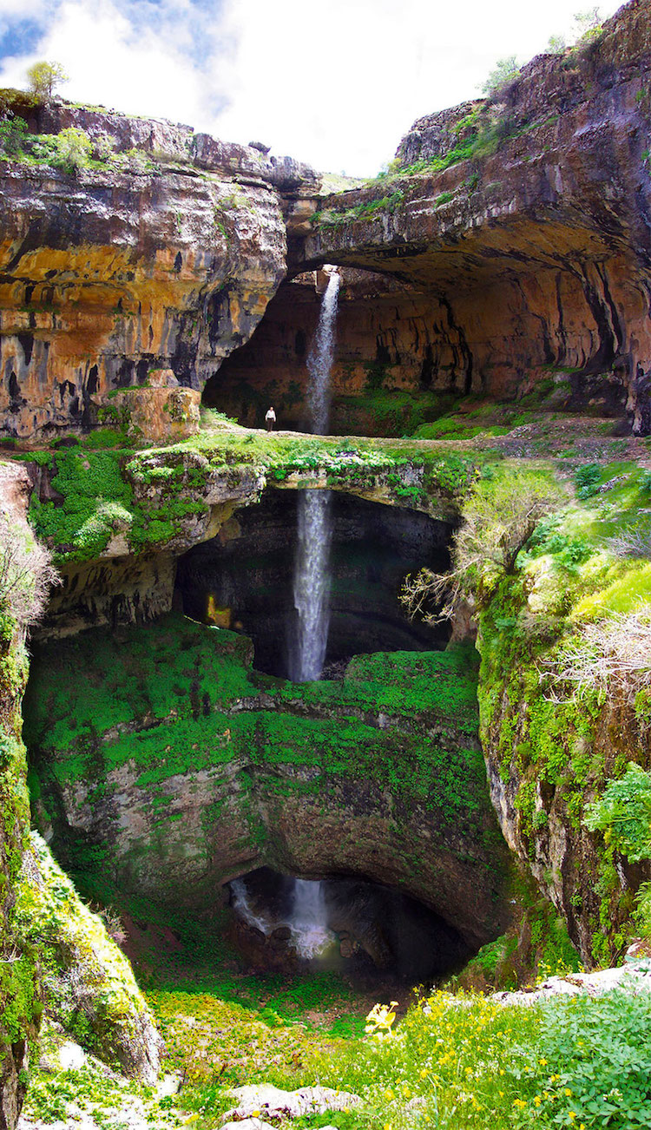

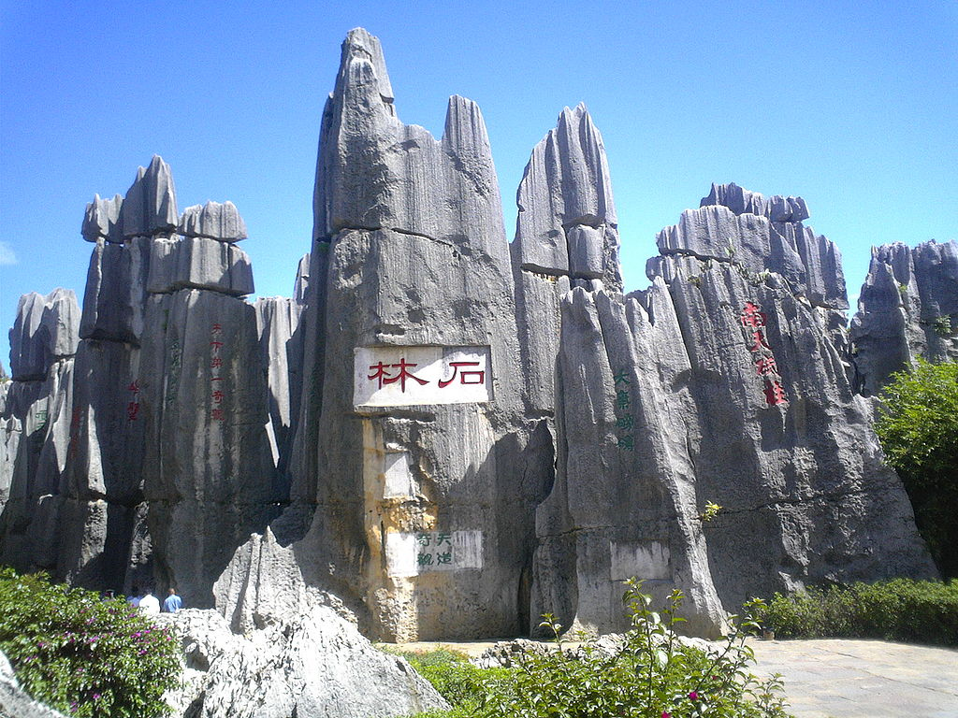

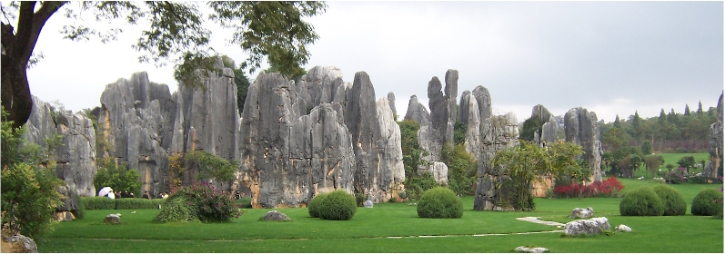
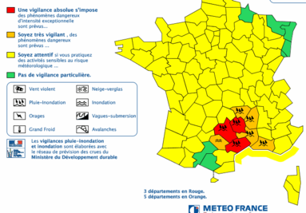
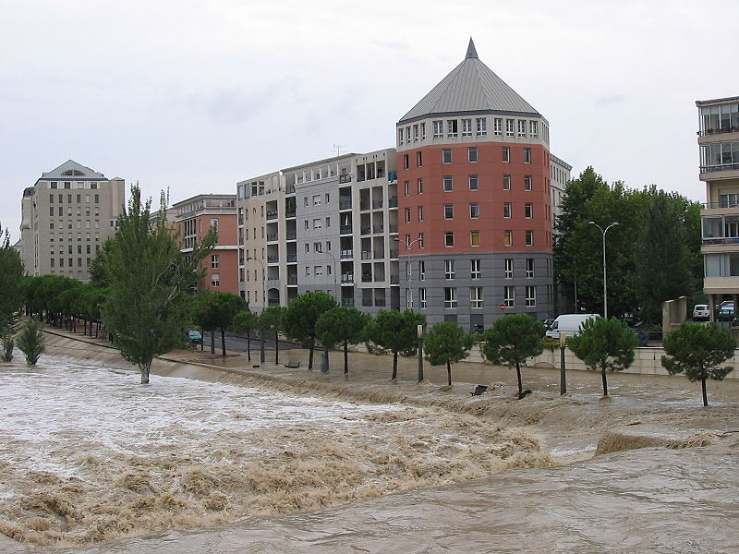
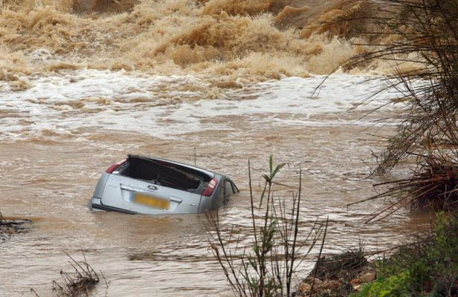
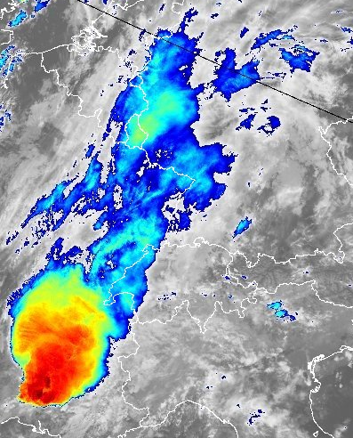
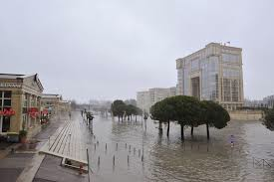
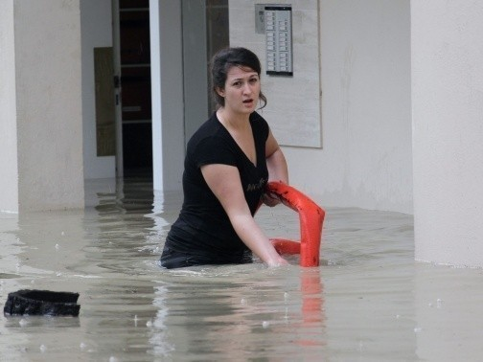
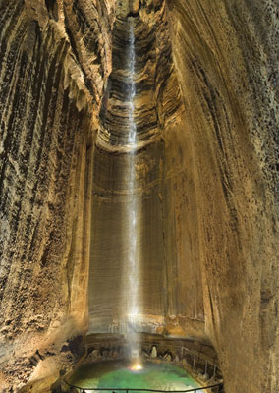
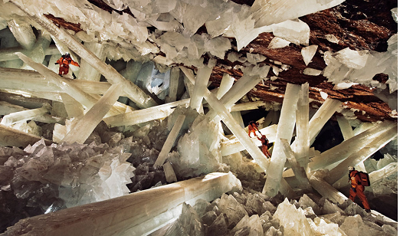
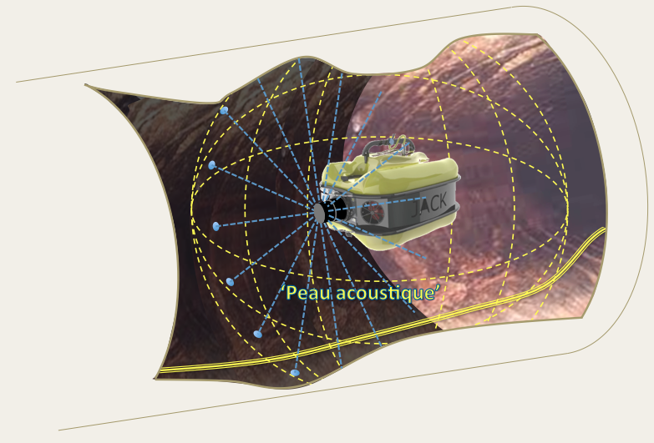
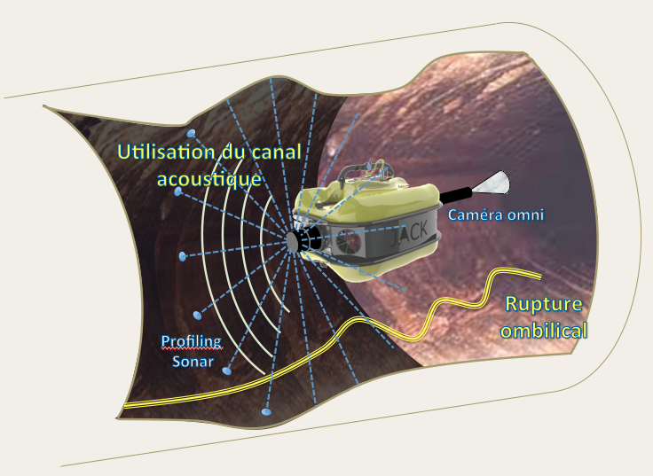
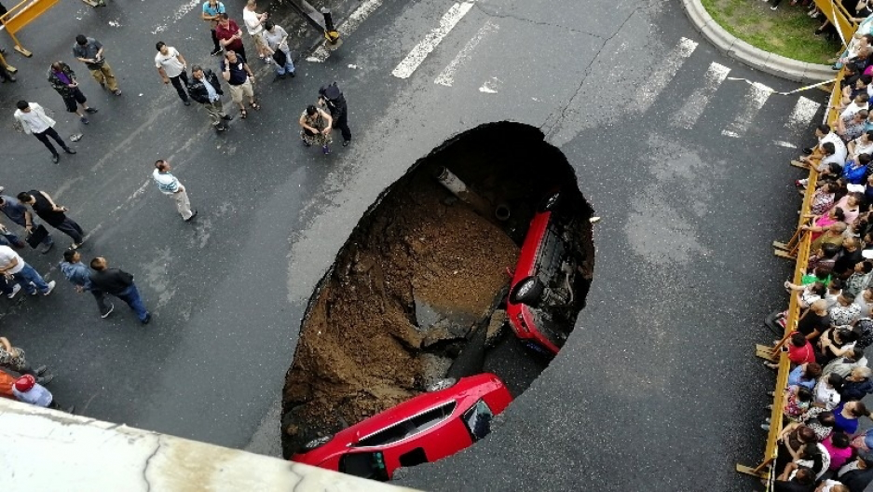
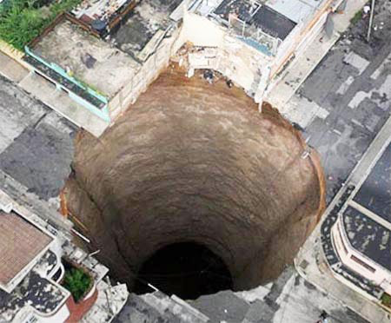
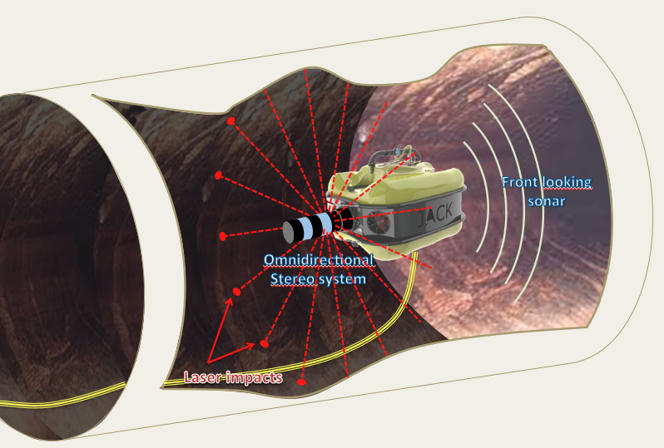
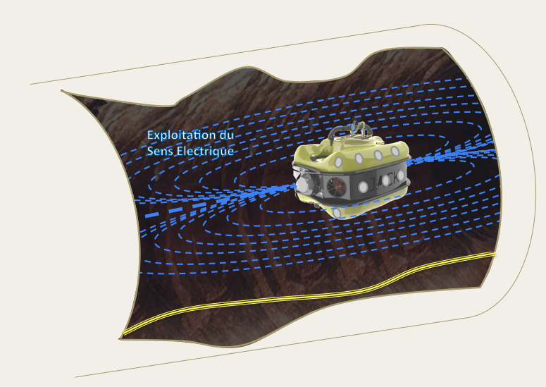
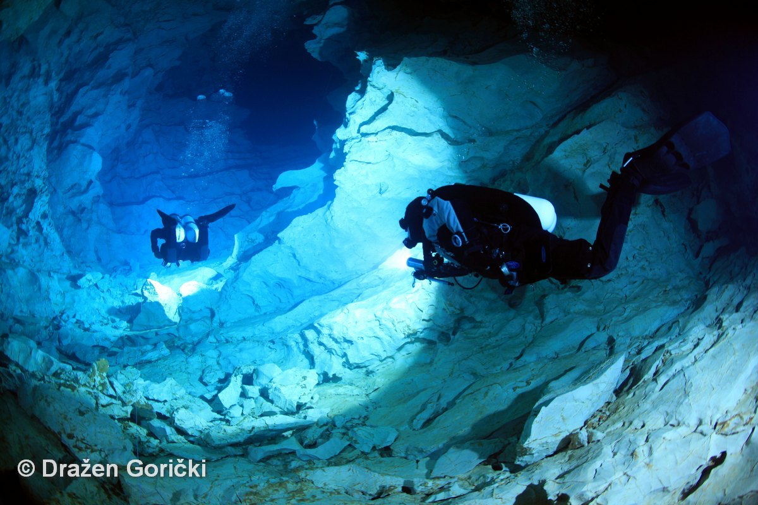
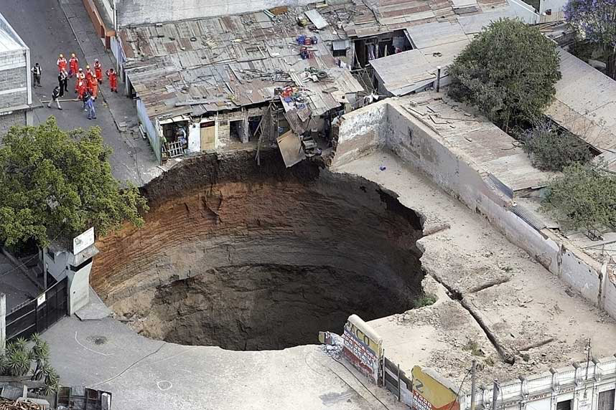
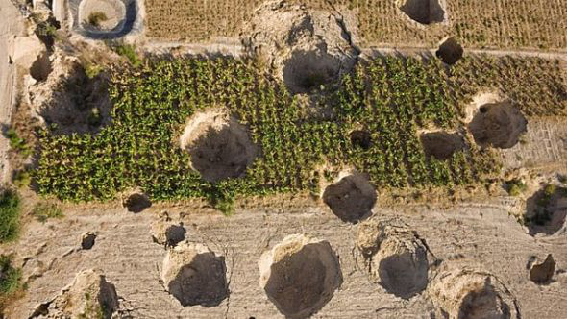
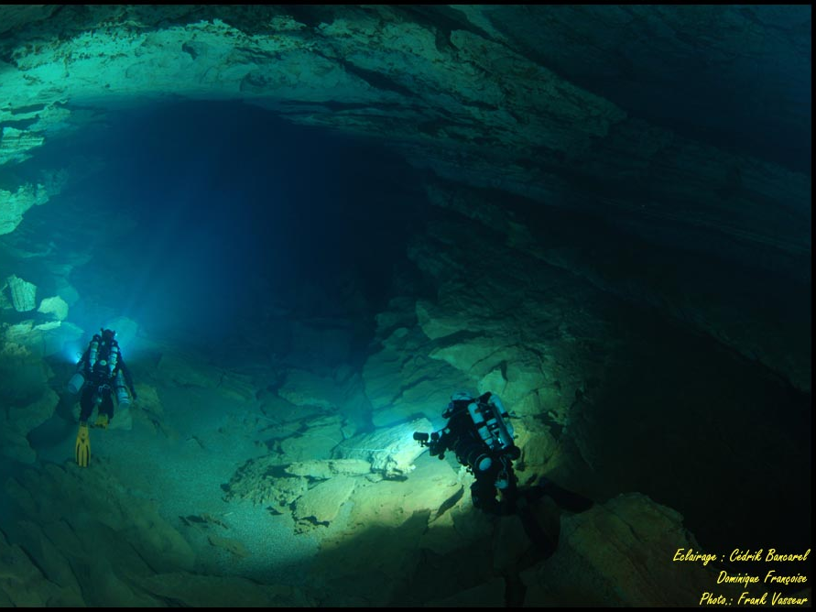
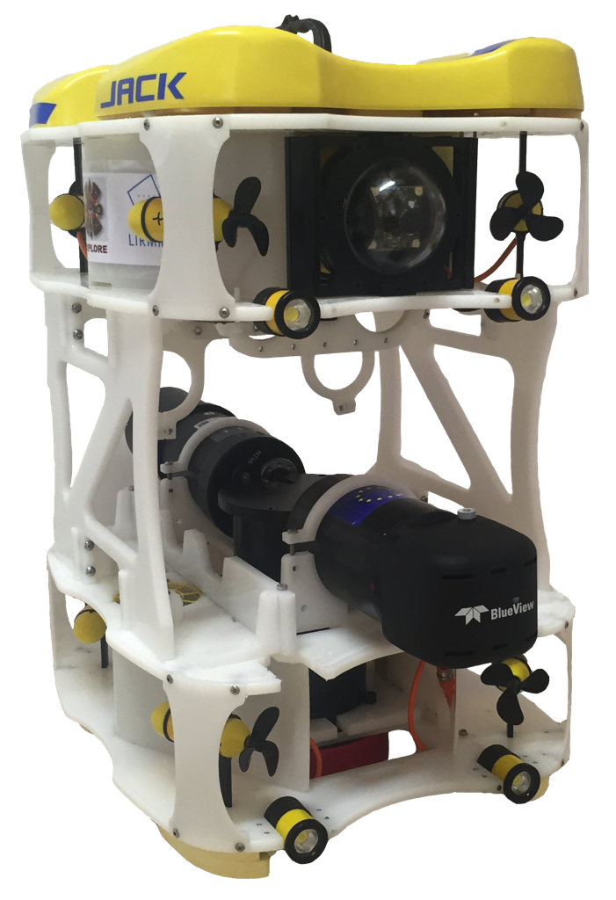
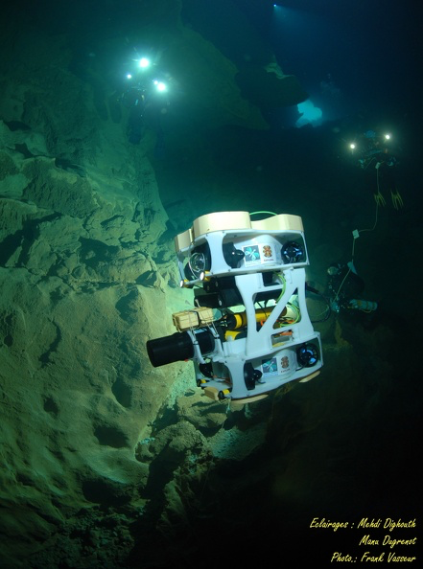
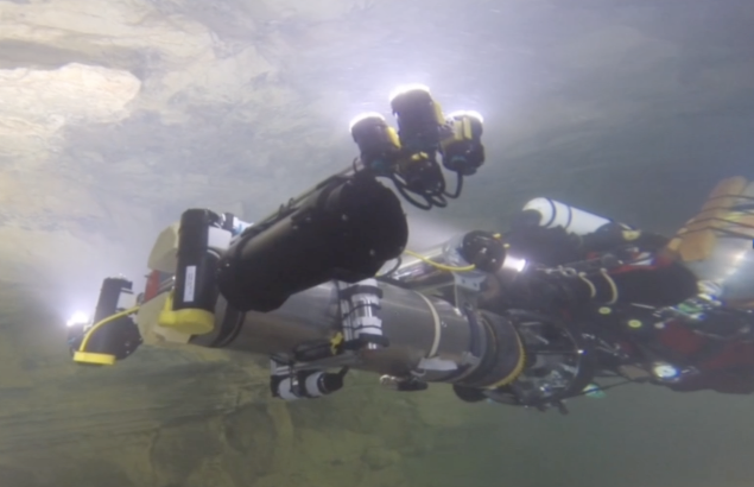
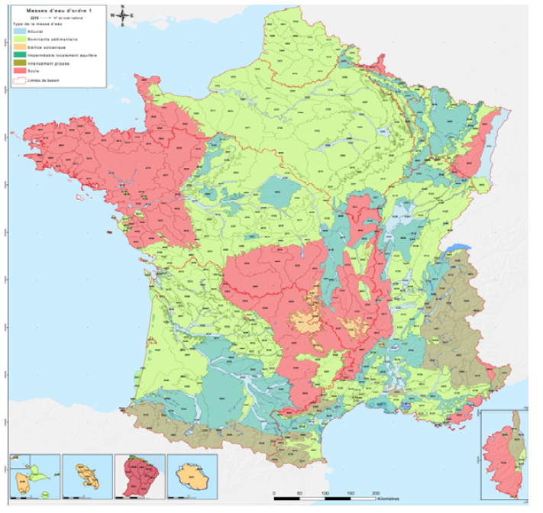
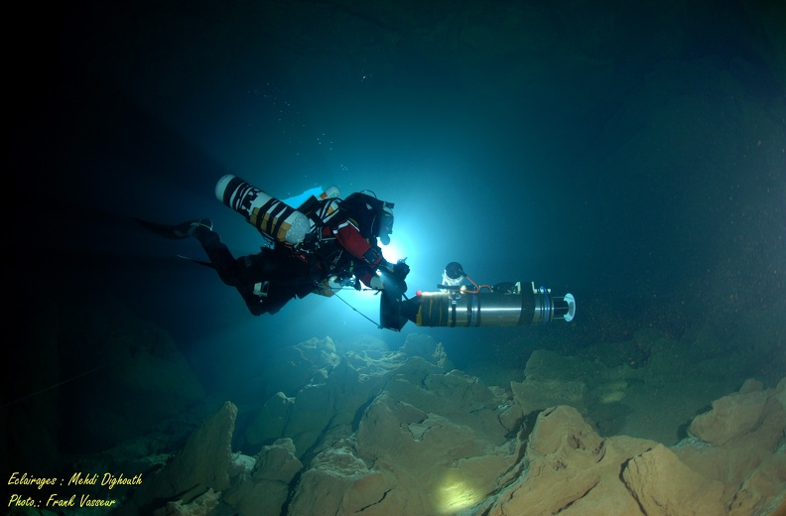
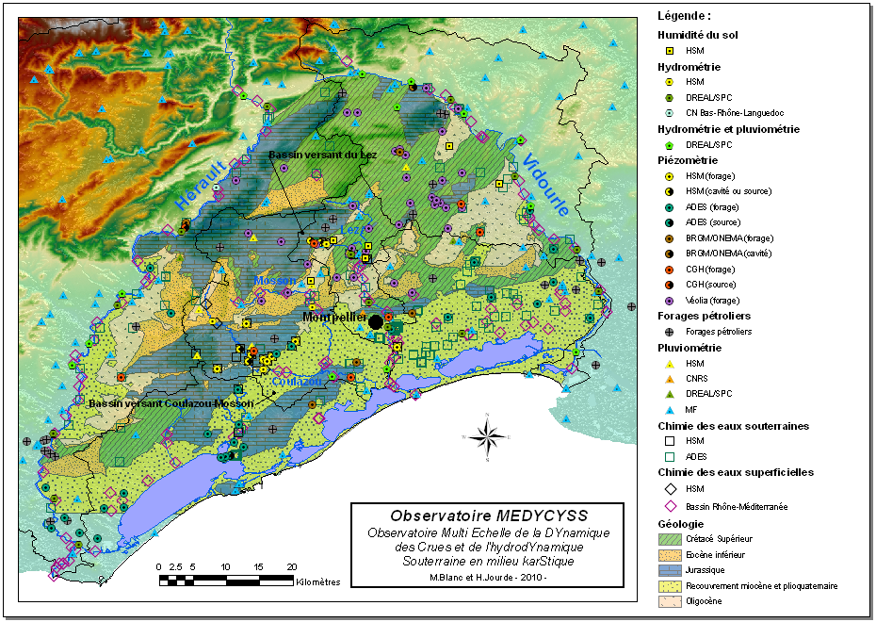







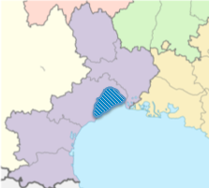
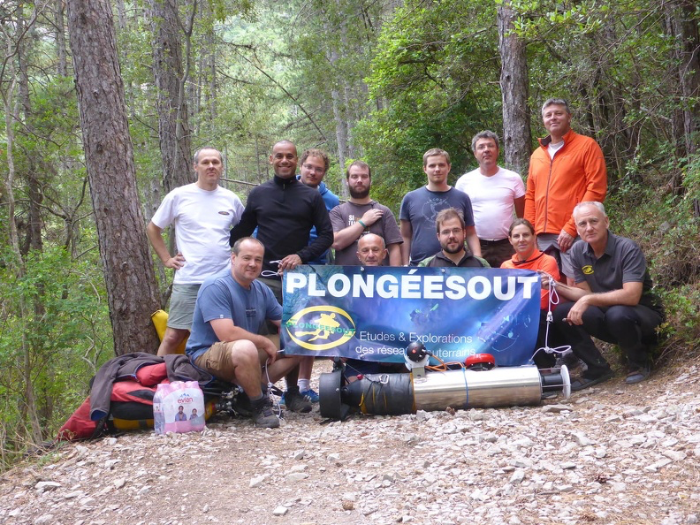
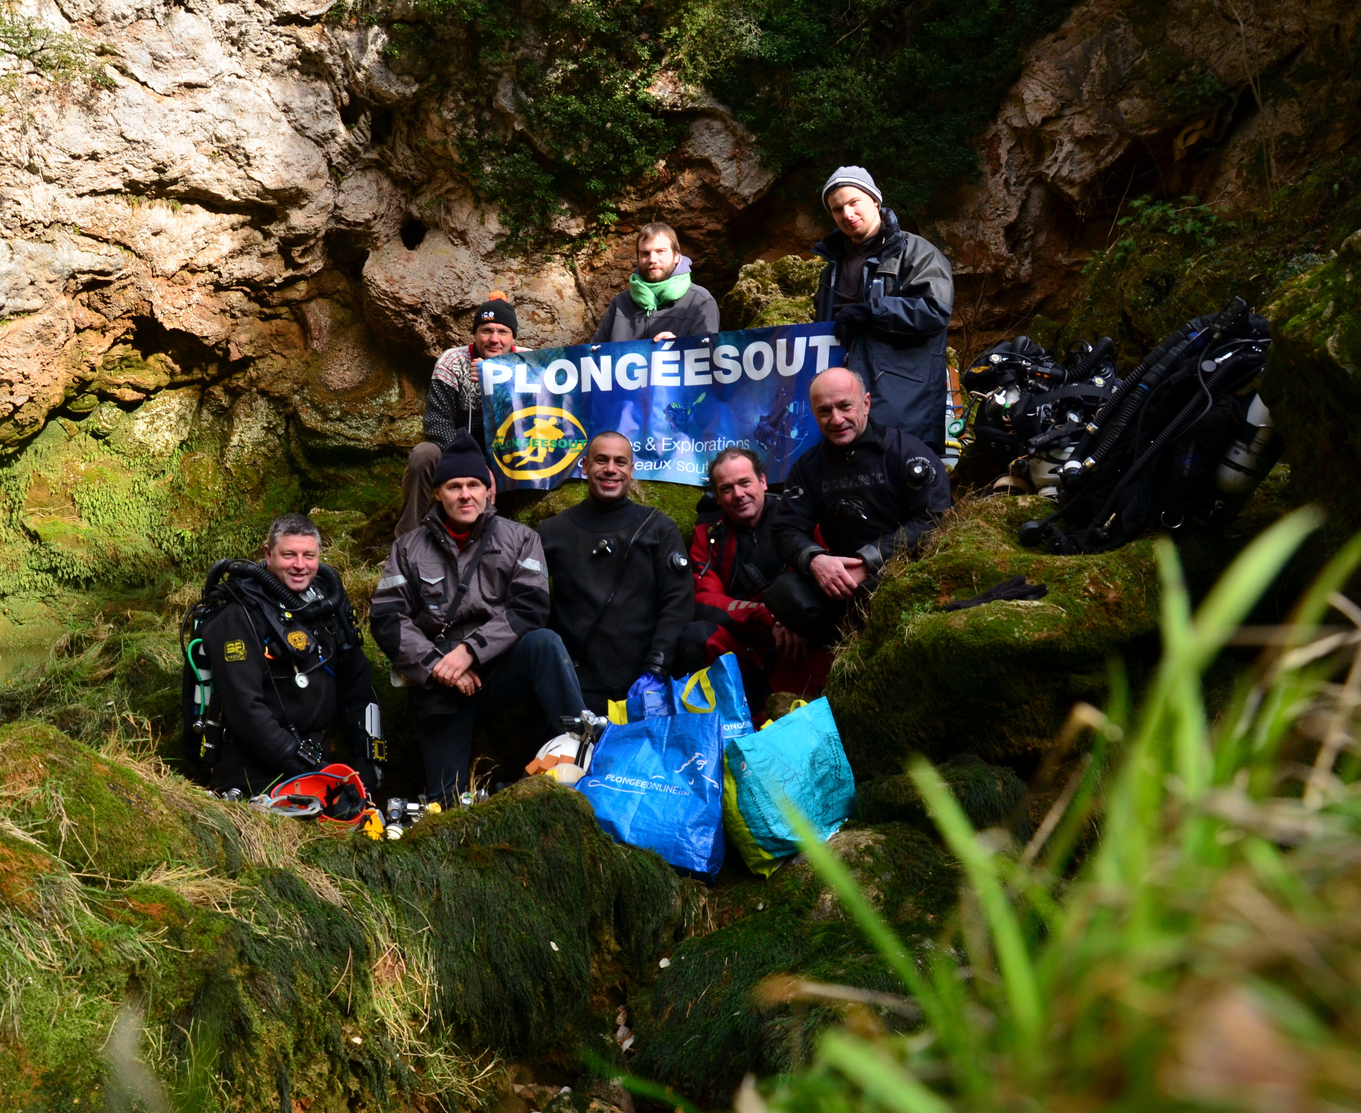
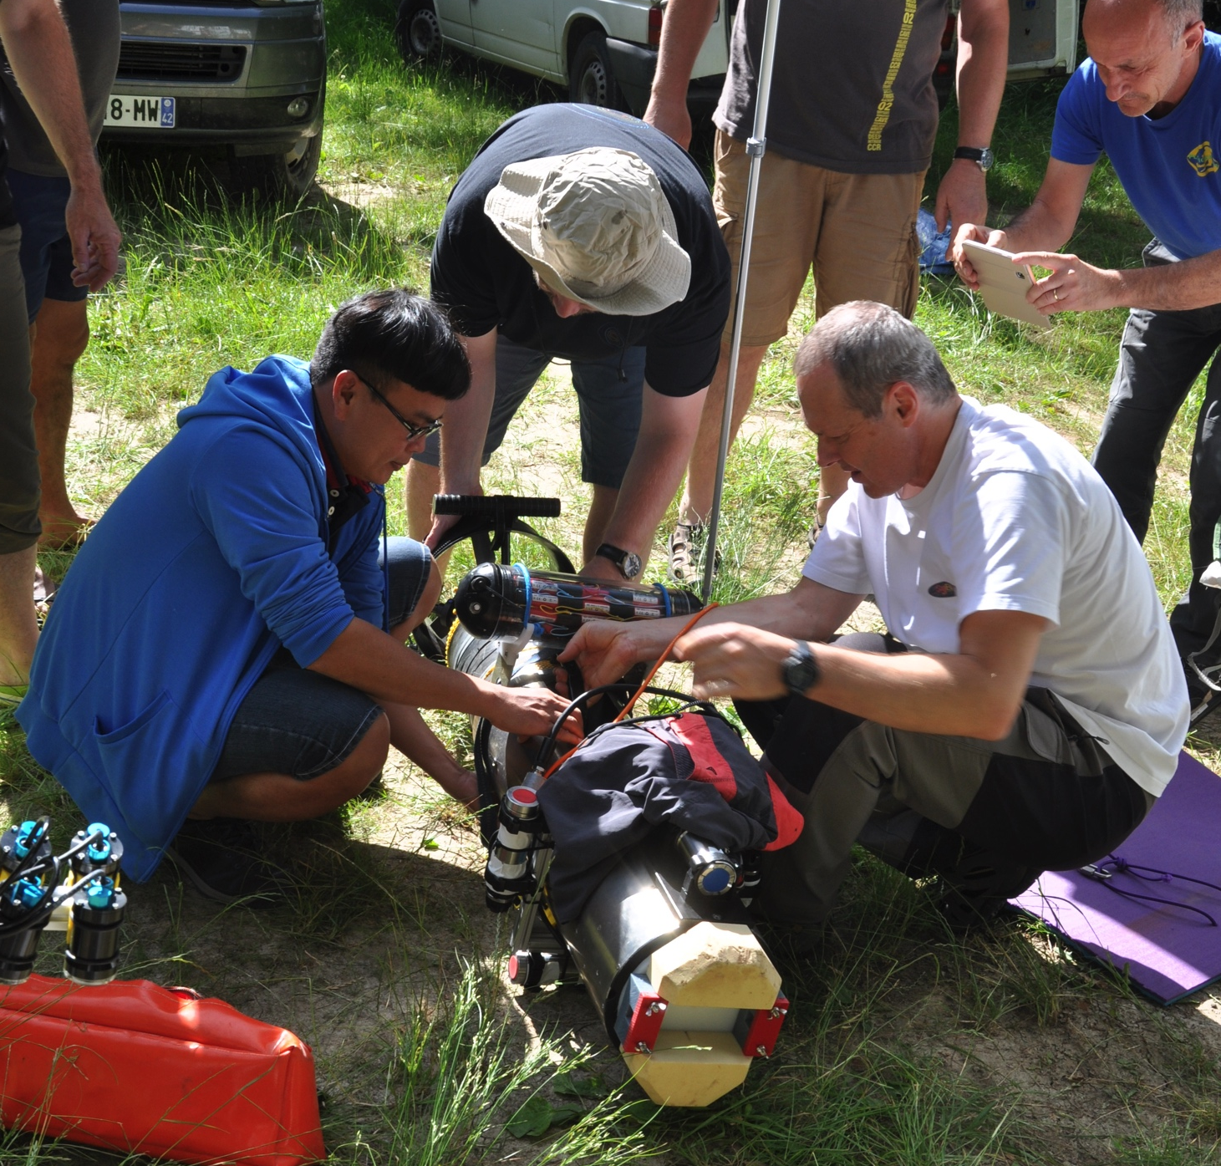
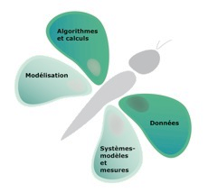
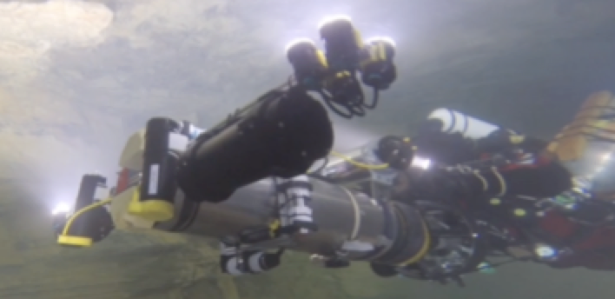
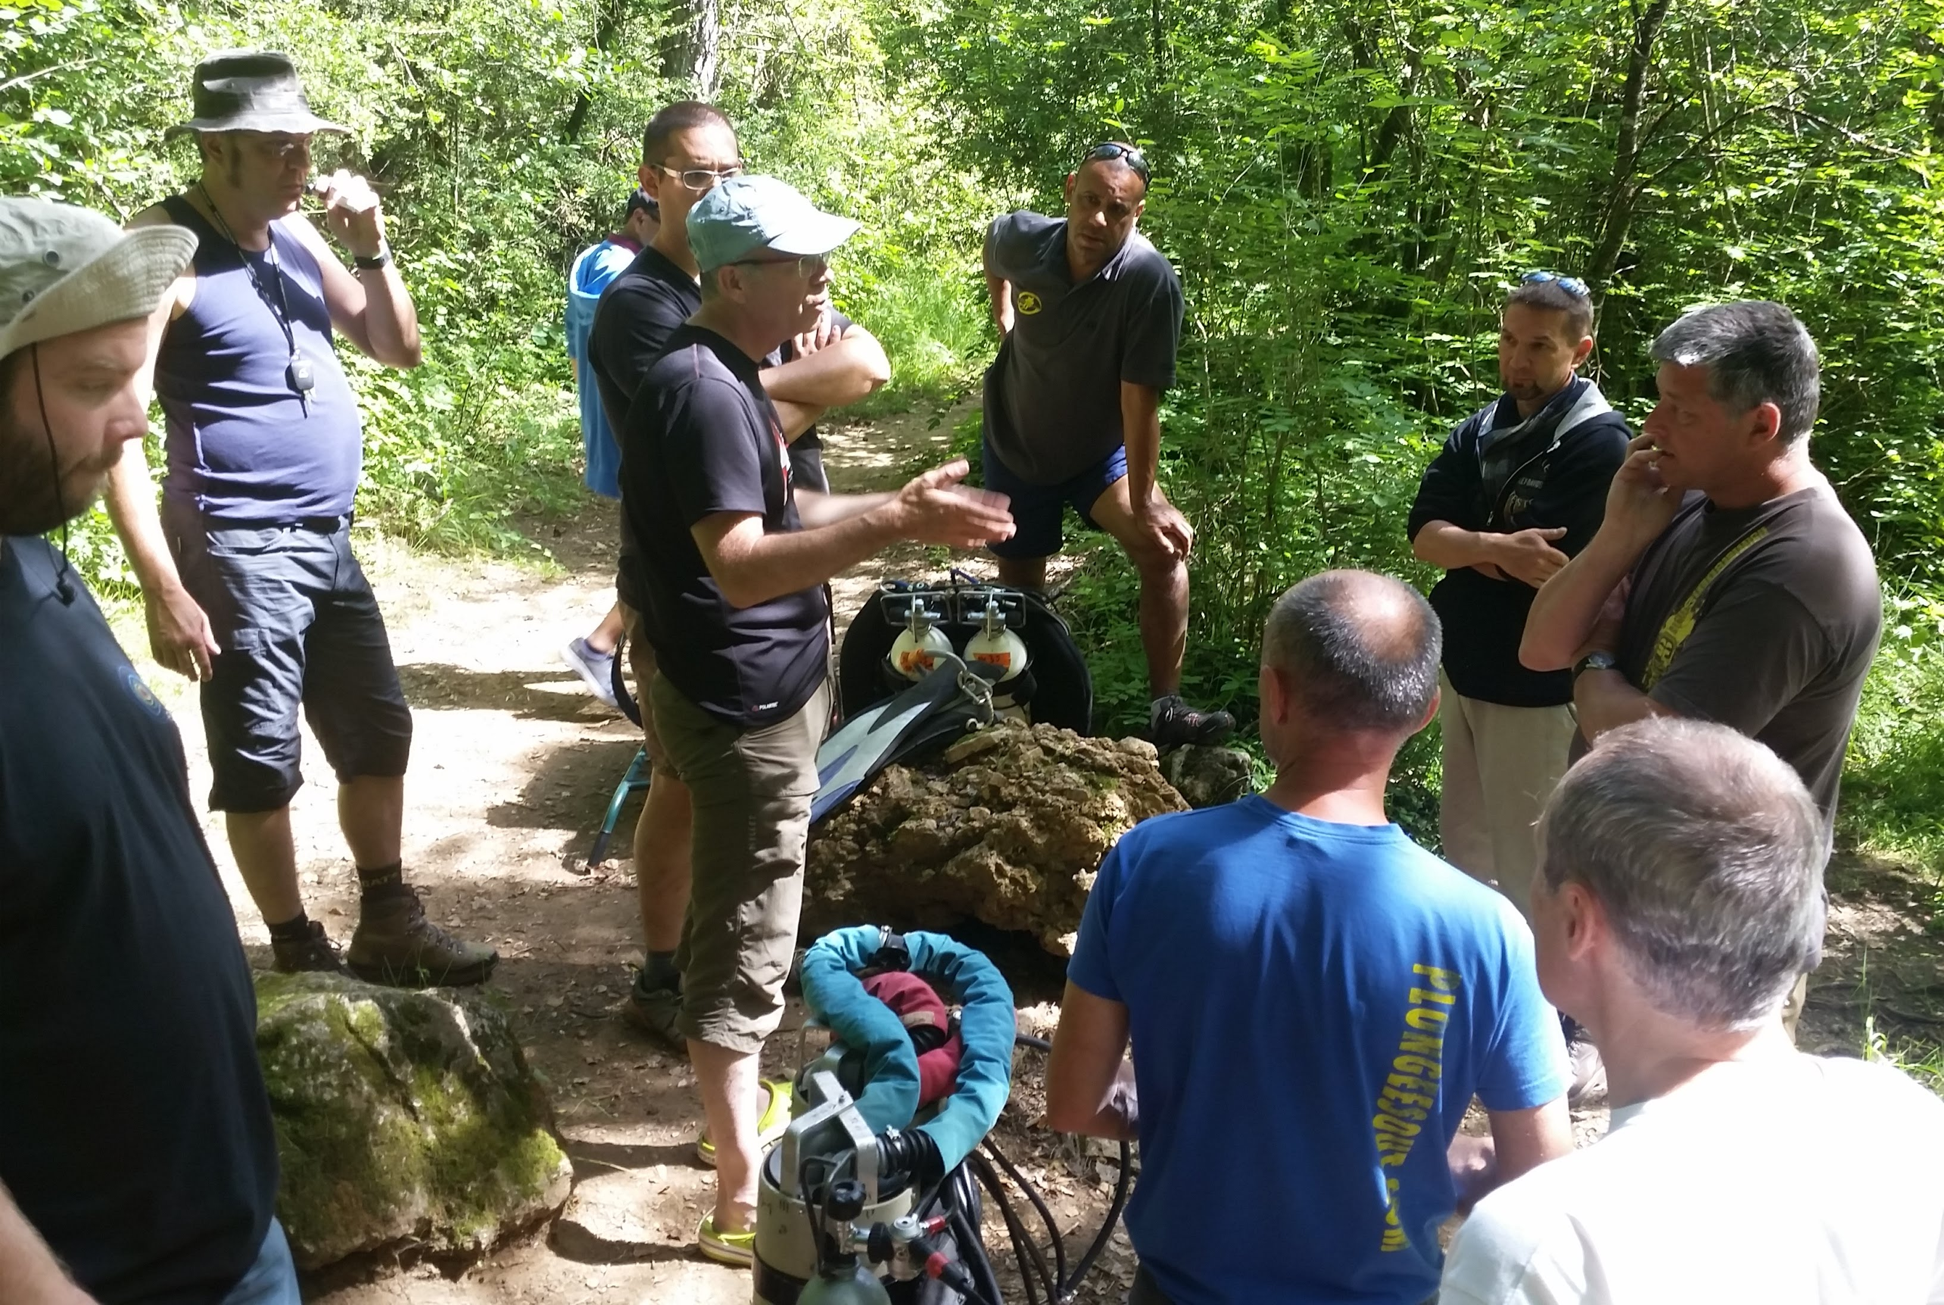
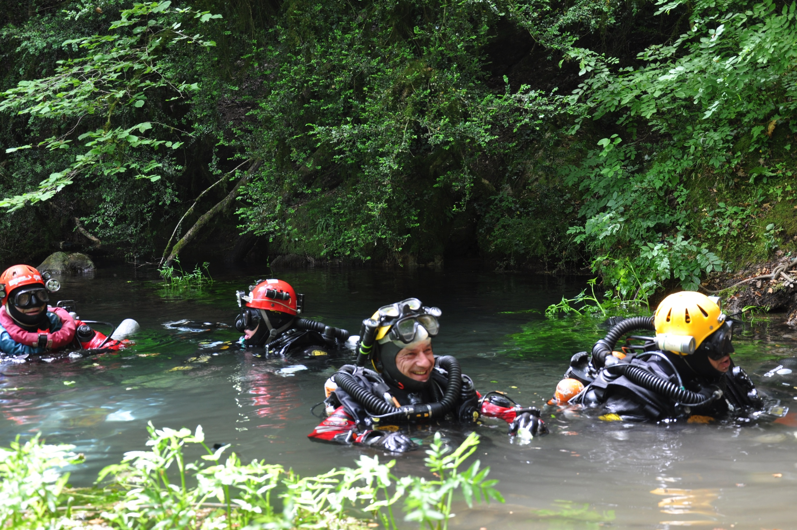
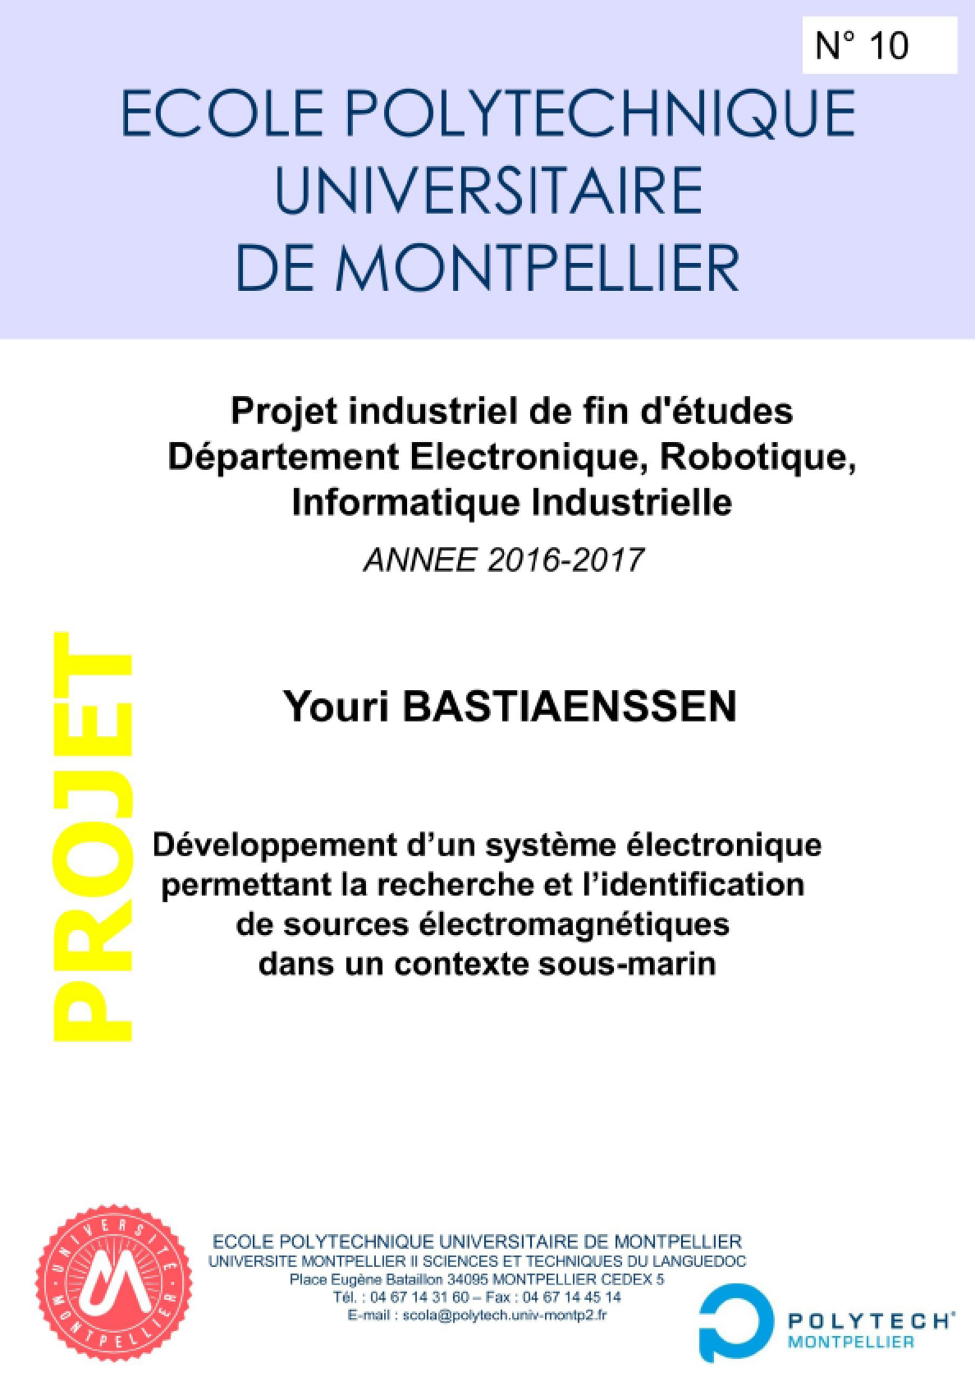
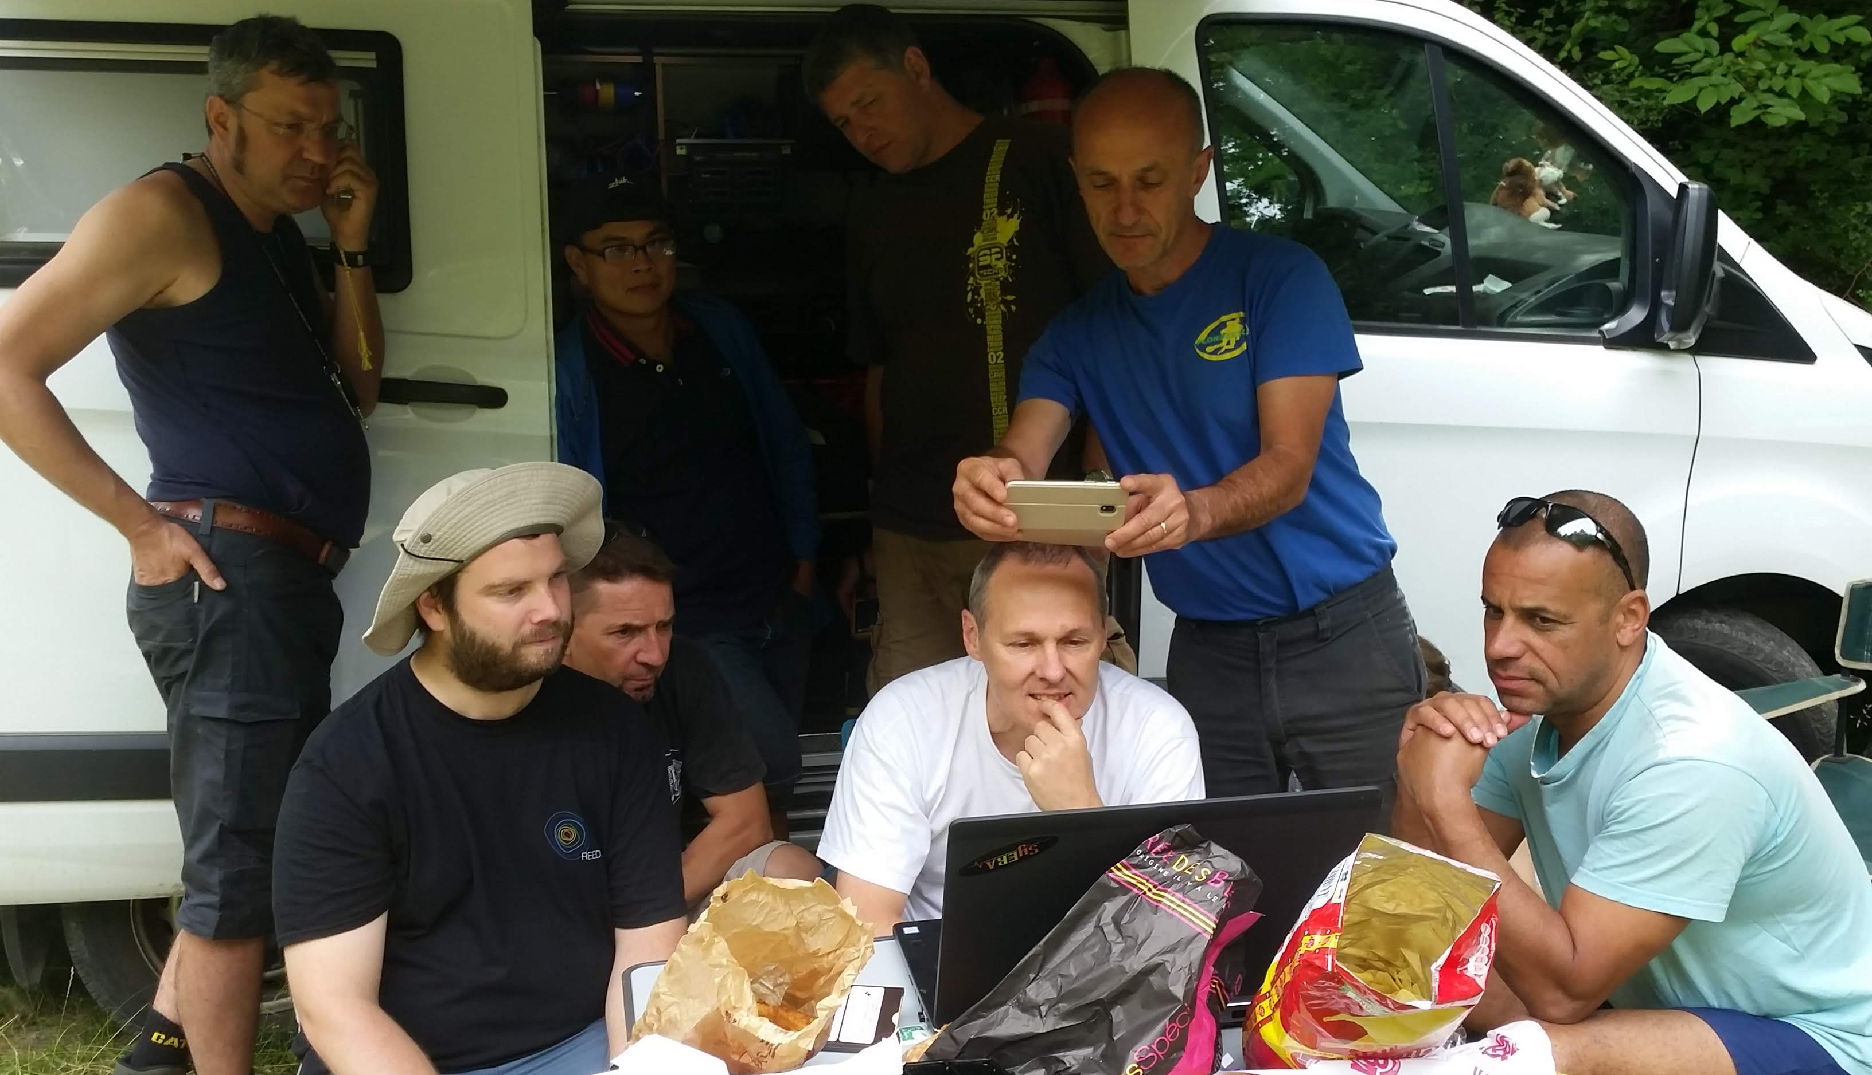
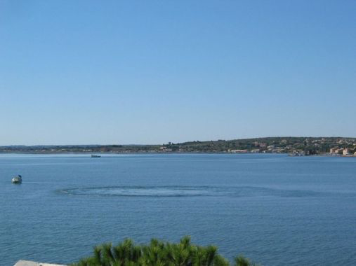
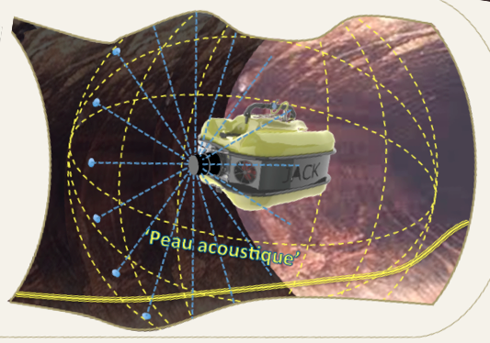
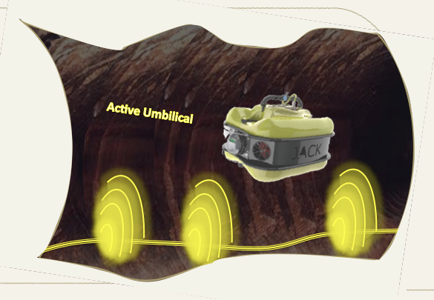

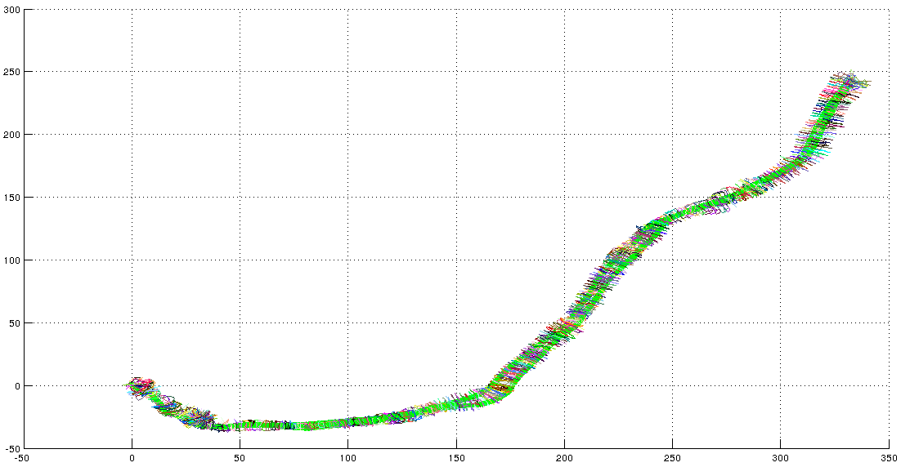
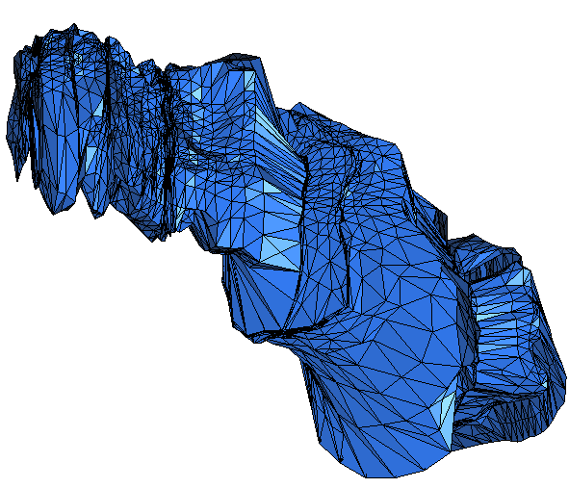
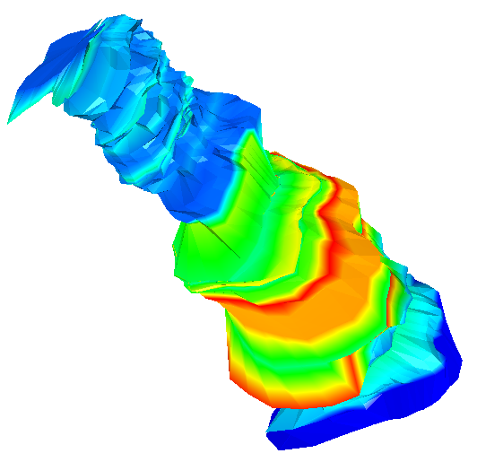
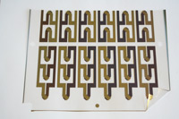
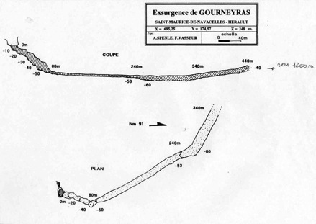
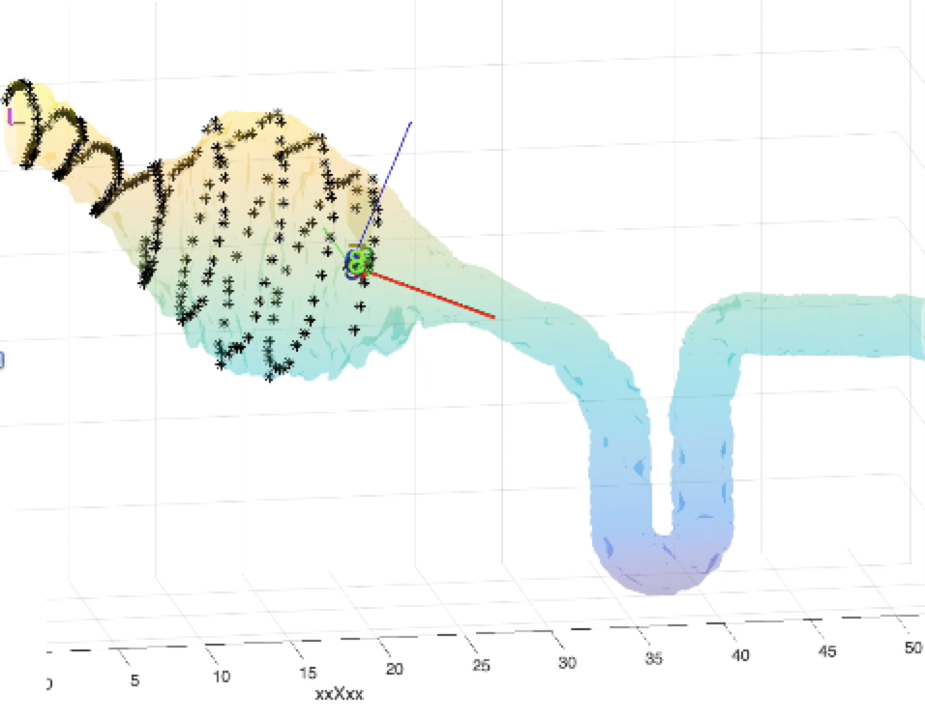
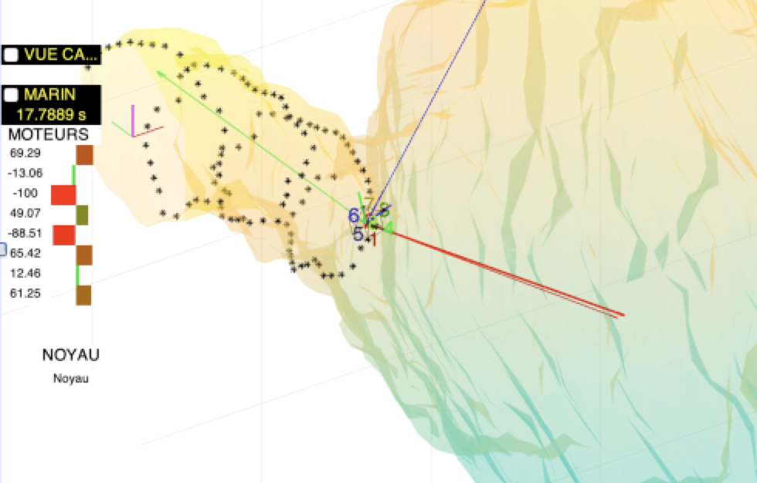
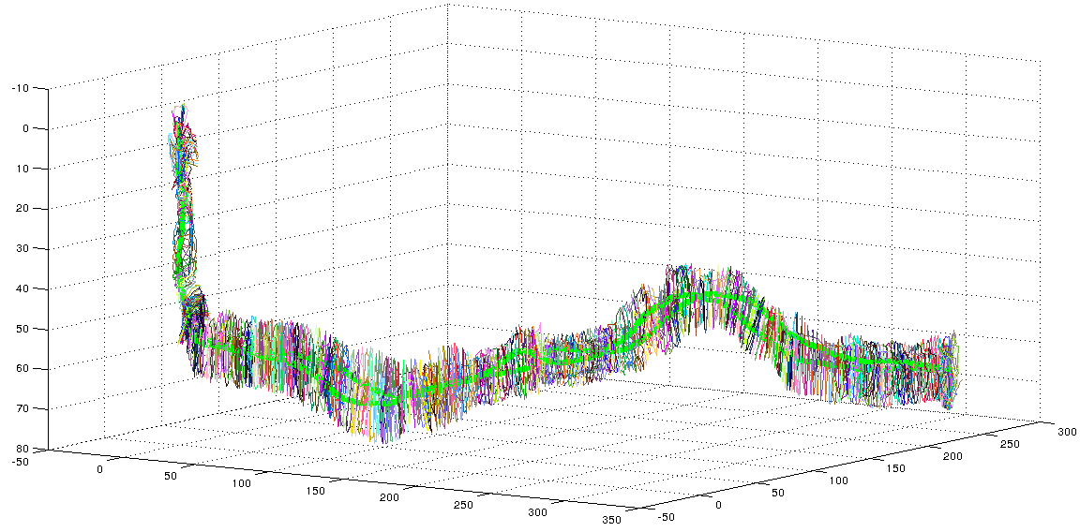















Karst: Definition
ALEYIN : an Underneath Karstic Robotic Journey
A topography formed from the dissolution of soluble rocks such as limestone, dolomite, gypsum and marble
L. Lapierre, H. Jourde, F. Augereau, B. Mohammadi, S. Yami, B. Ropars, L. Rossi
LIRMM, HSM, IES, IMAG, MRM/LEM, REEDS, SYERA
A flagship project of Labex Numev
Key words: Robotics, Water Resource Prospection, Protection, Active Management
RESUME/Abstract : The Aleyin Initiative aims at conceiving, designing and engineering an intelligent and practical robotic system to explore/inspect and characterize natural hydro-system consisting of flooded karstic network and mining/hydraulic galleries, contributing to the global challenge of prospection, protection, active management of the water resource and hydrogeological risk assessment and prevention.
Characterized by underground drainage hydrosystems with skinholes and caves.
Karst: Surface Stigmata
The Aleyin Initiative
Hydrogeological Risk Assessment
Subaquatic Autonomous System for Karstic Exploration
Montpellier’s Catchment Basin : a Seminal Case
Vector
(LIRMM)
Environnement
(HSM)
Balaa, Tannourine, Lebanon
Stone Forest, Shilin Yi, Yunnan, China
Karst: Underground Continuation
Raw data acquisition and model construction
Hydrogeological Risk : Skinholes
Cueva de los Cristales, Naica, Mexico
On-line model exploitation
Harbin, Heilongjiang province, China.
Guatemala City, Guatemala
New sensors
(IES)
Ruby Falls ,Chattanooga, Tennessee, USA
Vucovjica, Knin, Croatia
Env. Models
(IMAG)
Orlando, Florida, USA
Dead-Sea shore, Israel
Karst: Groundwater Reservoir
AUV/ASC for Underwater Fresh-Water Spring Localisation and Qualification
Terrain Results
Ulysse
  2x6 Thrusters
  IMU
  Camera
  Acoustic camera
  Profiling Sonar
  DVL
Systems
Gourneyras, 2016, 2017, Durzon, 2018
Gourneyras
Durzon, Nant, 24/06/2018
Karst: GW Management : a National Issue
Ulysse
HammerHead
+ 50% of Drinking Water Supply
Service National d’Observation du KARST,
SNO INSU/CNRS
OSU OREME (UM)
Coordinator H. Jourde
NavScoot
Forces at Work
ALEYIN PROJECT
Labex NUMEV
ALEYIN PROJECT
Labex NUMEV
ALEYIN PROJECT
Labex NUMEV
Carte hydrogéologique des formations carbonatées karstifiables (EASAC report)
New Sensors
Sources du Lez: a Seminal Study Case
Acoustic Skin
Active Umbilical
System Architectures
  Sensor Recruitment
  Adaptive Autonomy
  Dependability and GoP.
Gourneyras, 43°51'36.5"N 3°31'38.6"E, 11-14/07/2016
Gourneyras, 43°51'36.5"N 3°31'38.6"E, 21/01/2017
Durzon, 44.010185 N, 3.286986 E, 24/07/2018
Source du Lez, Simplifyed Topography
Mazzilli, 2011. Original topography by P. Rousset (G.E.P.S. diving group, 1972)
Stimulation Protocol
F. Augereau (IES)
D. Laux (IES)
M. Alarab (Thèse)
A. Gademer (IES)
A. Vena (IES)
D. Crestani (LIRMM)
L. Lapierre (LIRMM)
K. Godary (LIRMM)
R. Villalobos (Thèse)
🏡
GPS-Free Navigation
Volume (1187 m³)
Uncertainty map
Potential reservoir
~10⁵ m³
Underwater marine exsurgence
Navigation System
n-D SLAM
Vacancy Evidence grid
Unexplored zone
Towards Potential underwater
marine exsurgence
Littoral pumping
Y. Breux (LIRMM)
B. Mohammadi (IMAG)
A. Mas (IMAG)
Not the case of Source du Lez
Salted water wedge
J. Triboulet (LIRMM)
S. Druon (LIRMM)
A. Gademer (IES)
APPROVED
Guidance
  Autonomous Centring
  Autonomous Targeting
  Env. Models Inclusion
Control
  Robustness
  Co-Control
  Open-loop Stability
Demande d’aide Européenne
(programme operationnel feder-fse languedoc-roussillon 2014-2020)
Annexe specifique – « Recherche & Societe(S) »
R. Zapata(LIRMM)
P. Lepinay (LIRMM)
L. Lapierre (LIRMM)
D.H. Tho (Thèse)
B. Ropars(Reeds)
Actuation System
  Redundancy Management
  Adaptive Geometry
  Hyper-redundancy
R. Zapata(LIRMM)
P. Lepinay (LIRMM)
L. Lapierre (LIRMM)
D.H. Tho (Thèse)
B. Ropars(Reeds)
Acoustic Navigation
Projet LEZ 2020
2020-2023
Robotic Exploration of the « Sources du LEZ »
Robots Development
Photogrammetric Reconstruction
Ulysse
NavScoot
HammerHead
Cube
Anguilla
Sentinel
Telemaque

