Slide 1




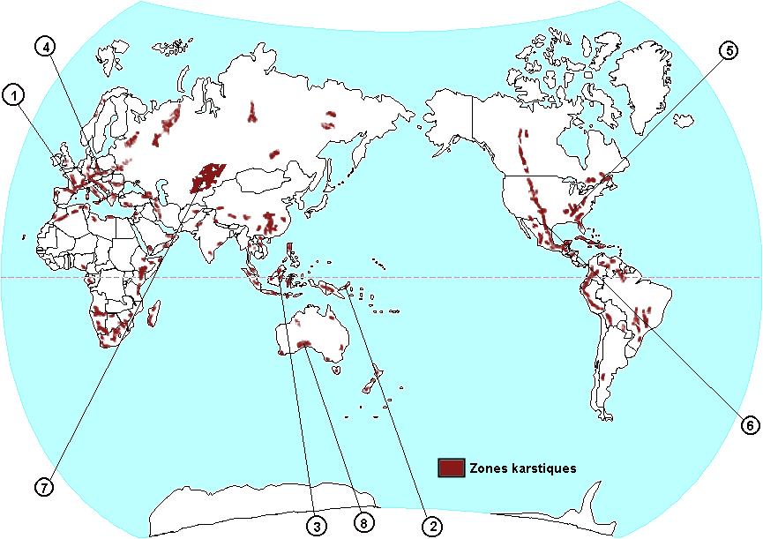
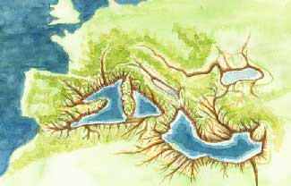
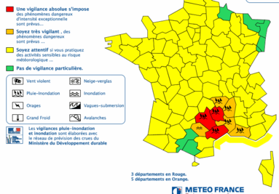
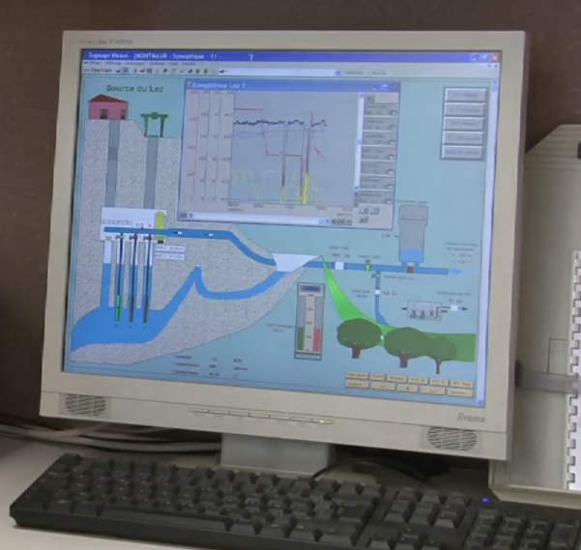
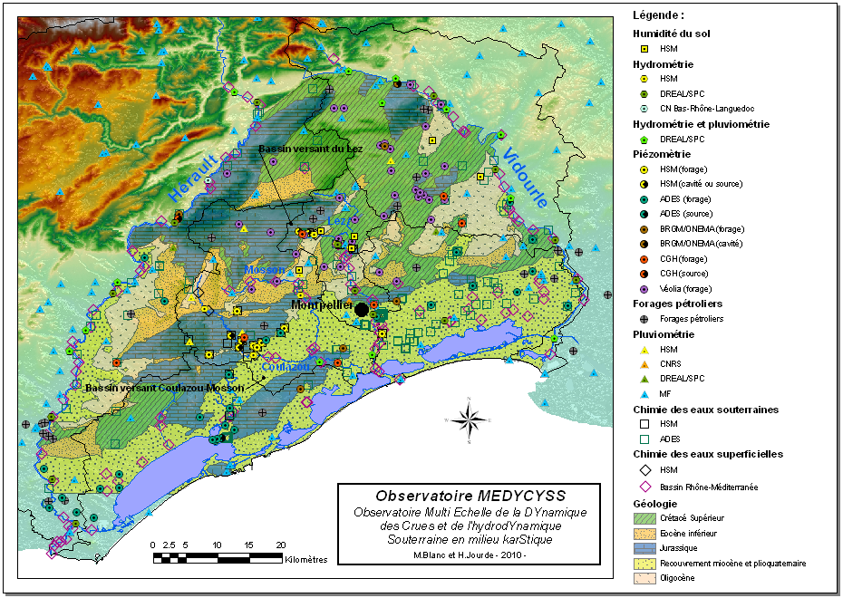
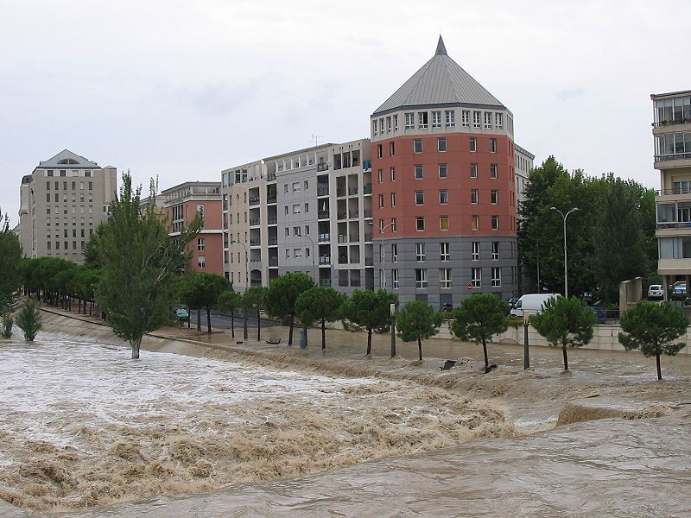
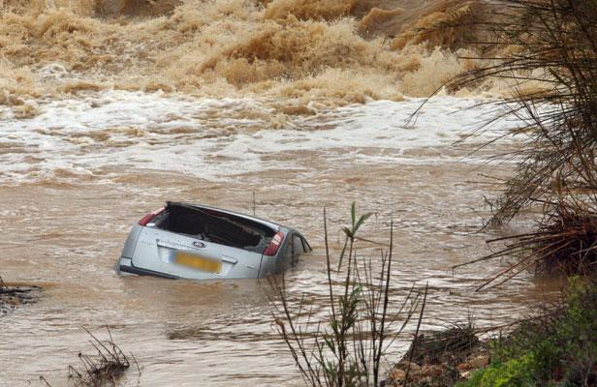
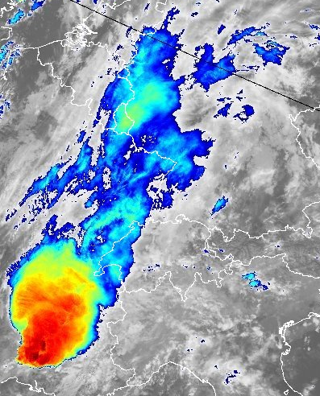
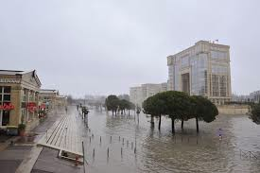
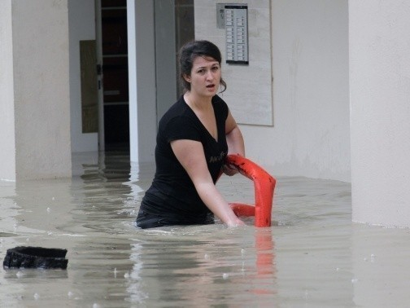
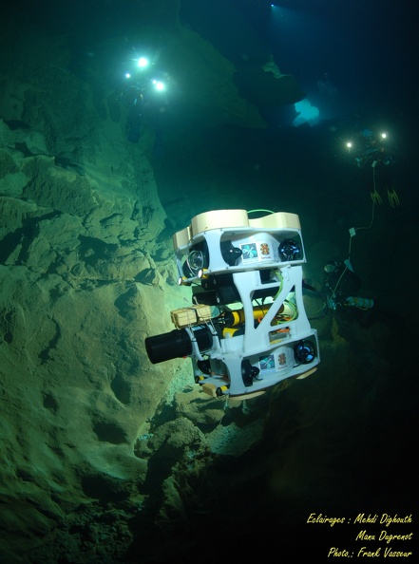
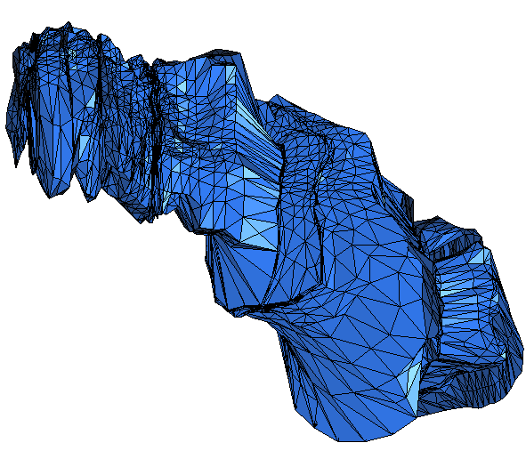
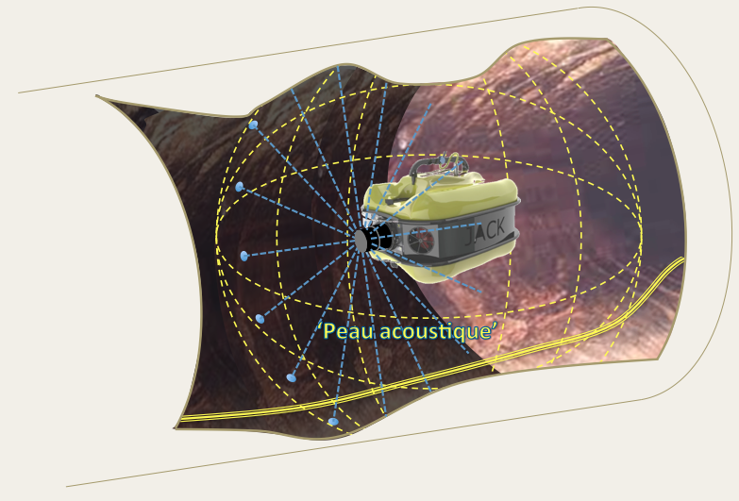
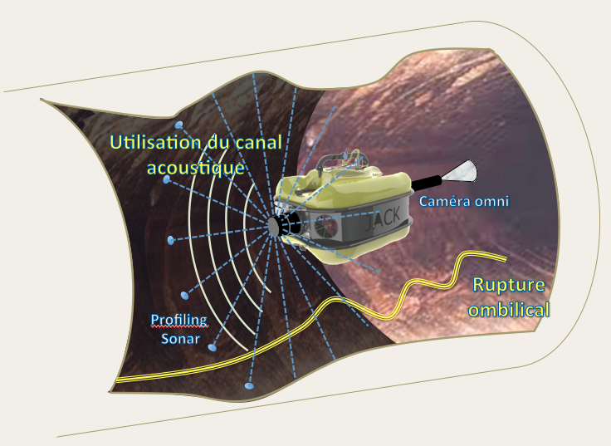
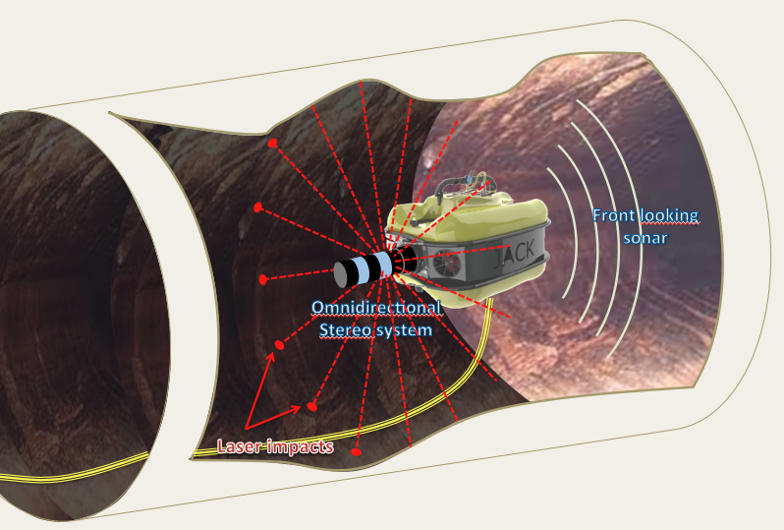
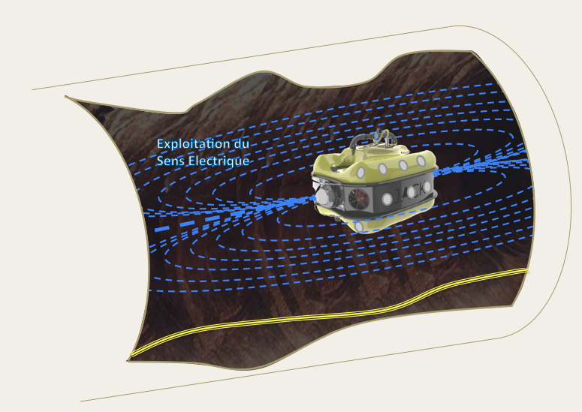
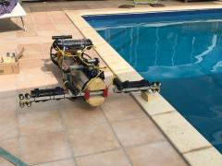
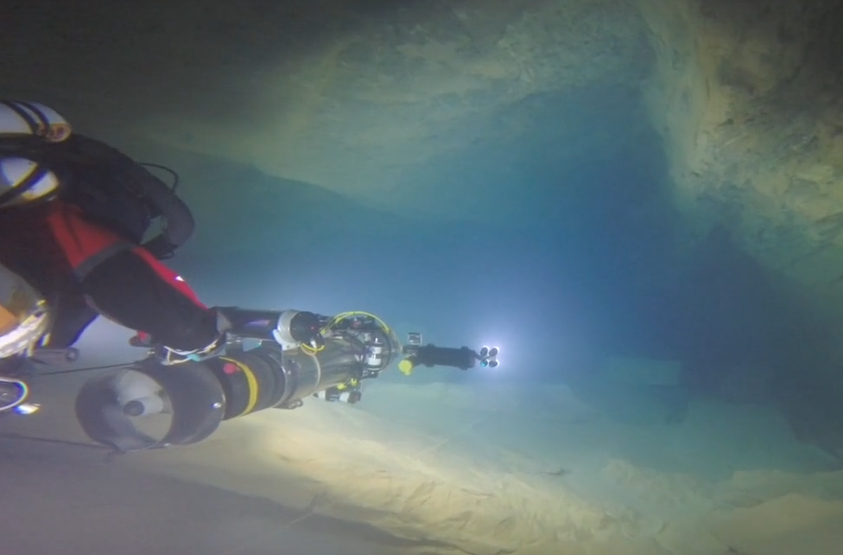
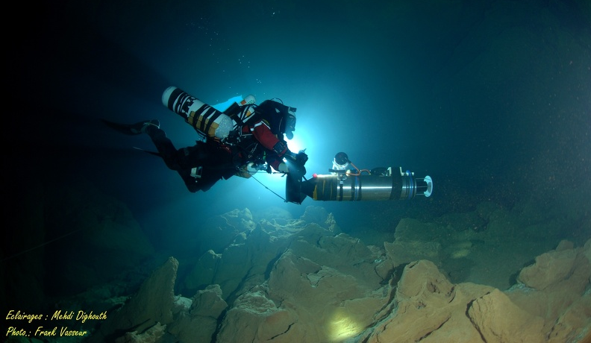
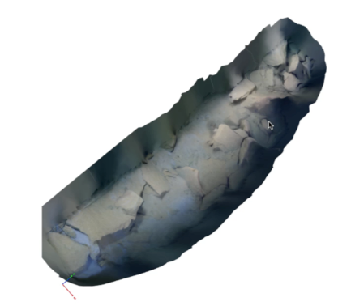
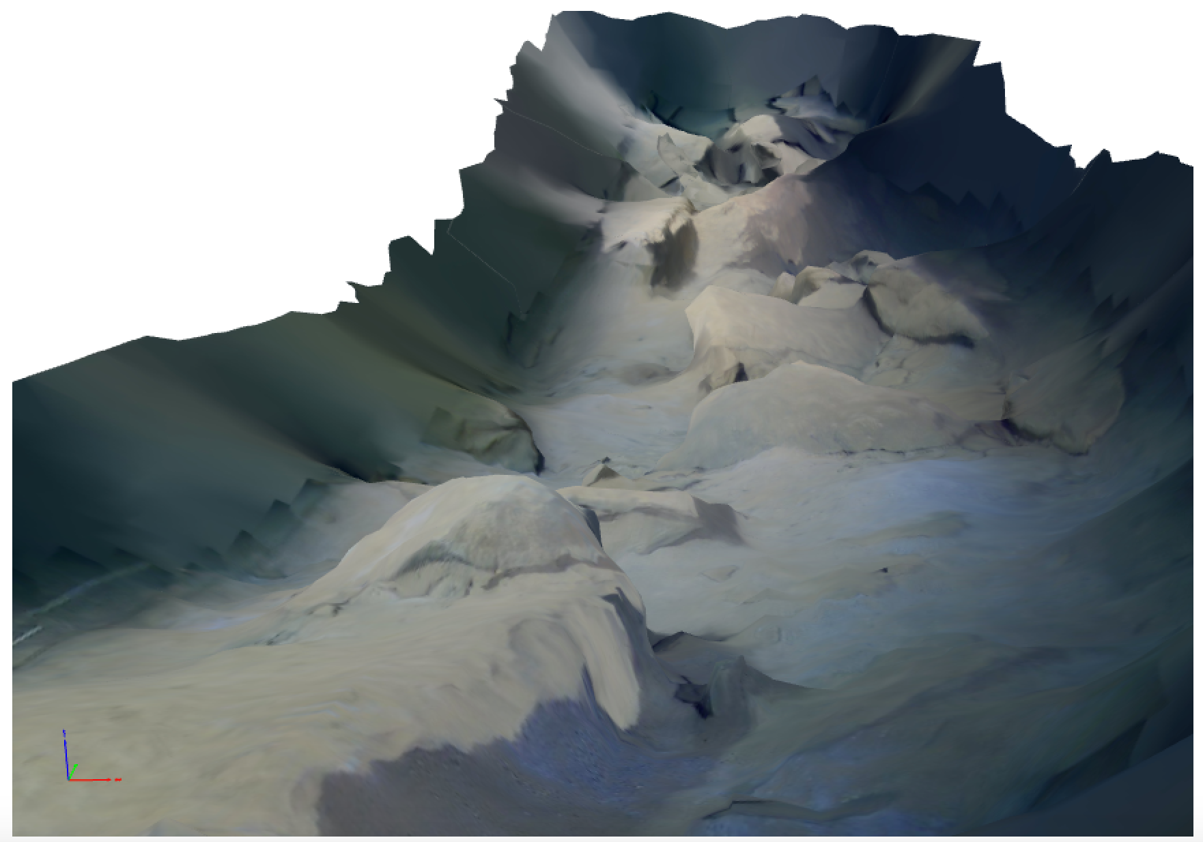
ALEYIN : an Underneath Robotic Journey
(Robotic Systems for karst exploration)
L. Lapierre, D. Andreu, A. Lasbouygues, D. H. Tho, S. Louis, J. Triboulet, S. Druon, A. Gademer, F. Augereau, B. Mohammadi, H.Jourde,
Industrial partners : , B. Ropars (REEDS), L. Rossi (SYERA),
Divers (PlongéeSout) : F. Vasseur, R. Bouchard, M. Dighouth, H. Délas, P. Balordi, M. Dugrenot, E. Jacquemin
Flagship Project.
Keywords: Prospection, Protection and Active Management of Water Ressource, Robotics, Acoustic Sensors, Environment Models
Abstract : The Aleyin proposal aims at conceiving, designing and engineering an intelligent and practical robotic system (i.e. Sensors System with Controlled Mobility) to explore/inspect underwater confined environment. As generic study case, the project focuses on karst exploration in order to provide in situ data to characterize underground hydrosystem dynamics.
Definition
National Issue
Mediterranean Shared History
World-Wide Stake
Messinian salinity crisis (0.6-0.3 My)
(deep karstification – 1500m)
Montpellier : a Seminal Study Case
Active Management of Underground Water Ressource and Hydrogeological Risk Prevention
Vector
(LIRMM)
Environment
(HSM)
Exploration phase :
raw data acquisition, model construction, co-control
Acoustic map of Gourneyras
Return phase :
model exploitation, autonomous navigation
New Sensors
(IES)
Models
(IMAG)
(partial) Photogrammetric
Reconstruction of Durzon

